Slide 1
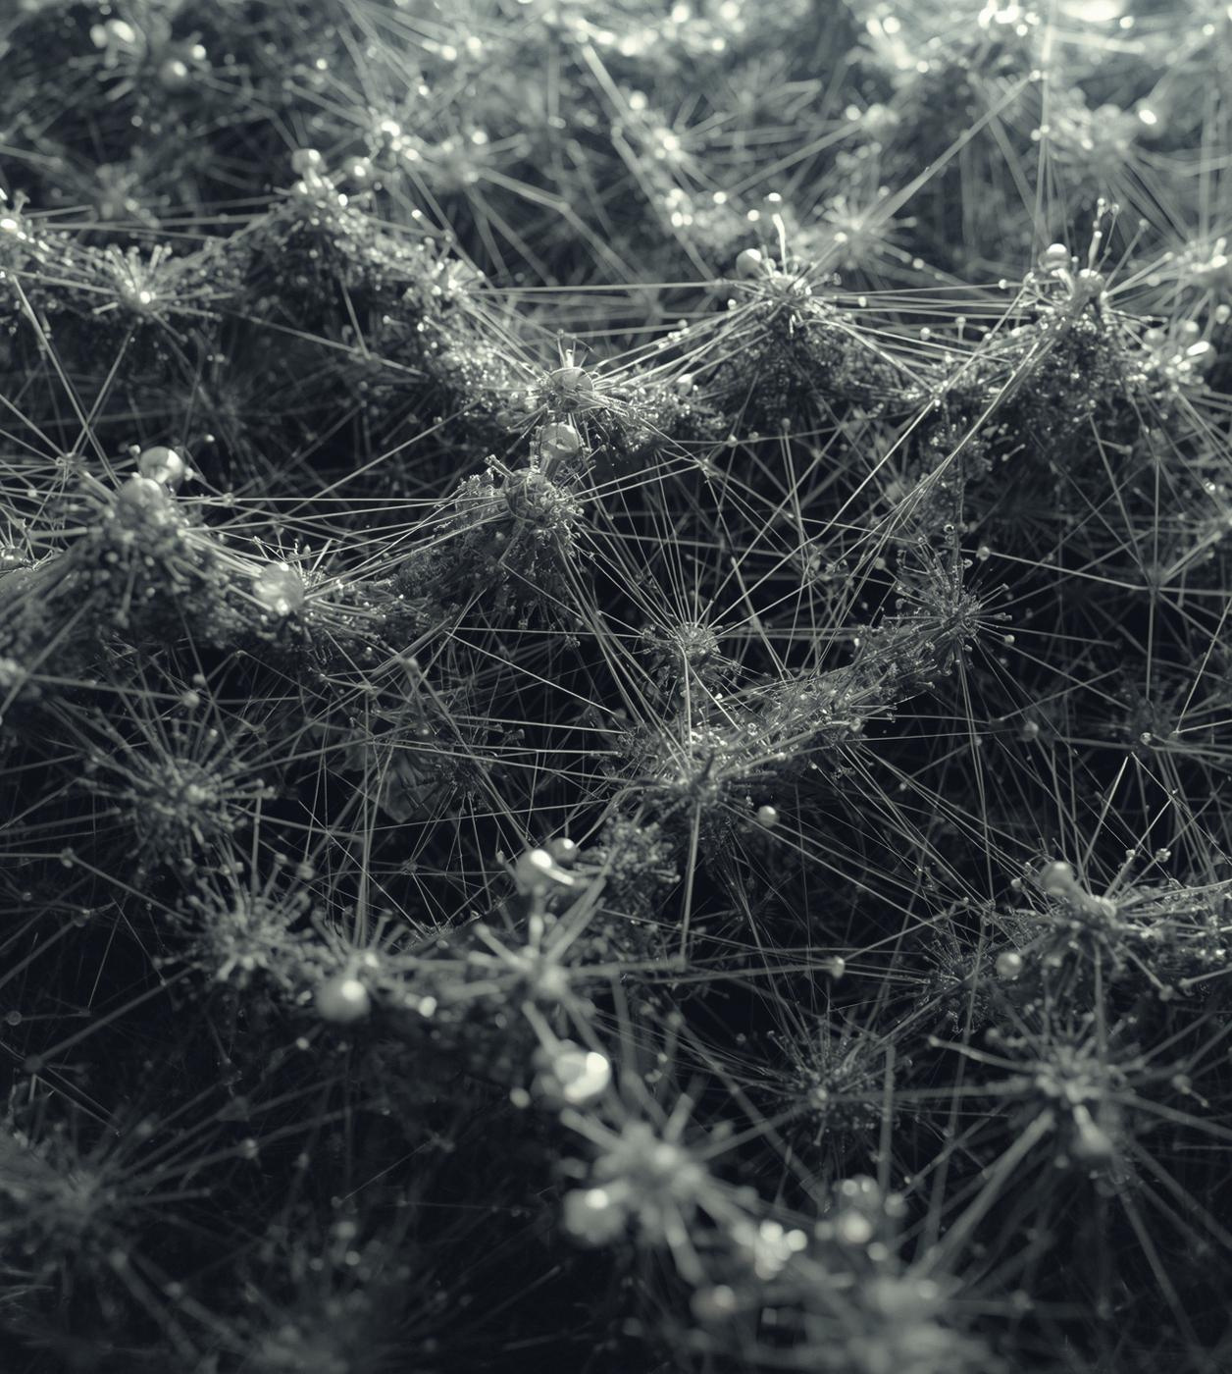

Optimization Research
Ant Colony Optimization
A comparative study of adaptive ant colony metaheuristic optimization methods applied to linear and nonlinear programming problems using numerical and simulation approaches.
By :
Ahmed Moatasem
Ali Mohab
Mohamed Darwish
Mohamed Tarek
Assem aldurni
Under Supervision of
Dr. Ahmed Abdelsamea
30 DECEMBER 2025
1

Slide 2


Abstract
Ant Colony Optimization (ACO)
• Population-based metaheuristic inspired by collective foraging
Continuous ACO Challenges
• Parameter sensitivity • Discretization effects • Limited precision
This Project: Adaptive ACO (AACO) + Hybrid Framework
• Global exploration via AACO
• Fast local convergence via Sequential Quadratic Programming (SQP)
Evaluation: 5D Rosenbrock & Rastrigin over 30 independent runs
• Hybrid AACO+SQP achieves 10,000× better accuracy than pure SciPy
2

Slide 3
Nonlinear Programming Background
Mathematical Problem
min f(x) subject to: g(x) ≤ 0, h(x) = 0
The Challenge: Multiple Local Minima
• Non-convex landscapes with many local optima
• Performance depends on: initialization, search strategy
Classical Solvers (Local Methods)
Strong: Efficient local convergence, high precision
Weak: Poor global exploration, initialization-dependent
Our Approach: Combine global + local search
3

Slide 4
Sequential Quadratic Programming (SQP)
How SQP Works
• Solves via sequence of quadratic subproblems
• Uses gradients & Hessian approximations (quasi-Newton)
Strengths
• Superlinear convergence near optimum
• Industry standard (SciPy, MATLAB, industry)
• Achieves machine-precision solutions (1e-10+)
Weaknesses
• Sensitive to initial point
• Trapped in local minima (multimodal problems)
• Poor global exploration
4

Slide 5
Adaptive Ant Colony Optimization (AACO)
Core Components
• 40 ants represent candidate solutions
• Search space discretized into 60 bins/dimension
• Pheromone matrix τ_{d,j} guides sampling
Adaptive Parameter Scheduling (Linear)
• α(t): Pheromone influence → increases (exploits learned regions)
• β(t): Heuristic influence → decreases (reduces random exploration)
• ρ(t): Evaporation rate → increases (fine-tunes near optimum)
Timing Effect
• Early: More exploration (low α, high β)
• Late: More exploitation (high α, low β)
5

Slide 6
AACO: Sampling Probability & Updates
Sampling Probability for Bin Selection
p_{d,j} ∝ τ_{d,j}^α · η_{d,j}^β
• τ_{d,j}: Pheromone learned from elite ants
• η_{d,j}: Heuristic term (favors center bins)
Elite Selection & Pheromone Deposit
• Select top 15% ants each iteration
• Elite deposit: τ_{d,j} ← τ_{d,j} + 1/f_best
• Evaporate: τ_{d,j} ← (1-ρ)·τ_{d,j}
Stability Bounds
• Clamp pheromone to [1e-6, 1e6]
• Prevents premature convergence to single region
6

Slide 7


Hybrid AACO–SQP Framework
Two-Phase Optimization
Phase 1 : AACO Global Exploration (150 iterations)
• 40 ants explore entire search space
• Identify promising region → best solution x_AACO
Phase 2 : SQP Local Refinement (300 iterations)
• Warm-start from x_AACO (not random!)
• Deterministic convergence to high-precision optimum
Why It Works
• AACO escape local optima → SQP refines to machine precision
• Synergy: Robustness (AACO) + Accuracy (SQP)
7

Slide 8

Experimental Setup & Configuration
AACO Hyperparameters
• Ants: 40 | Iterations: 150 | Bins/dim: 60
• Elite fraction: 15% | Pheromone bounds: [1e-6, 1e6]
SQP Hyperparameters
• Max iterations: 300
• Gradient: Finite differences (ε = 1e-6)
Experimental Rigor
• 30 independent runs per method (statistical validation)
• Fixed random seed: 42(reproducibility)
• 2 benchmark problems: Rosenbrock & Rastrigin (5D each)
8

Slide 9
Optimization Methods Compared
Baseline Methods (SciPy Black-box Solvers)
1. SciPy SLSQP (random init)
2. SciPy L-BFGS-B (random init)
Pure ACO Method
3. Scratch AACO (global search only)
Hybrid Methods (Our Contributions)
4. AACO + Projected Gradient Descent (lightweight)
5. AACO + SQP (proposed method)
→ Uses industry-standard SQP for refinement
9

Slide 10


Experimental Results: Accuracy (Mean ± Std)
Rosenbrock Function (5D)
Hybrid AACO+SQP: 2.73×10⁻⁷ ± 1.00×10⁻⁷ [BEST]
• Hybrid AACO+PGD: 2.00 ± 0.17
• Scratch AACO: 3.97 ± 0.12
• SciPy SLSQP: 1.18 ± 1.83
• SciPy L-BFGS-B: 0.92 ± 1.69
Rastrigin Function (5D)
Hybrid AACO+SQP: 1.23 ± 0.43 [BEST]
• Hybrid AACO+PGD: 1.23 ± 0.43
• Scratch AACO: 7.11 ± 0.06
• SciPy SLSQP: 32.83 ± 13.58
• SciPy L-BFGS-B: 36.18 ± 11.52
10

Slide 11
Robustness & Computational Analysis
Convergence Patterns
AACO Phase: Steady global exploration (0-150 iter)
SQP Phase: Rapid refinement (150-300 iter)
Hybrid reaches best values fastest & consistently
Robustness (Box Plot Analysis, 30 runs)
Hybrid AACO+SQP: Low variance (σ < 1.0)
Pure SciPy: High variance (σ ≈ 11-13)
→ SciPy depends heavily on random initialization
Computation Time
• Hybrid AACO+SQP: ~1.4 sec | SciPy: ~0.01 sec
• Hybrid 10,000× more accurate → time justified!
11

Slide 12
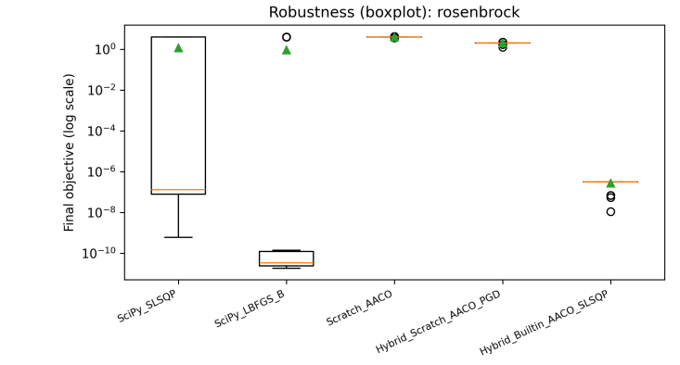
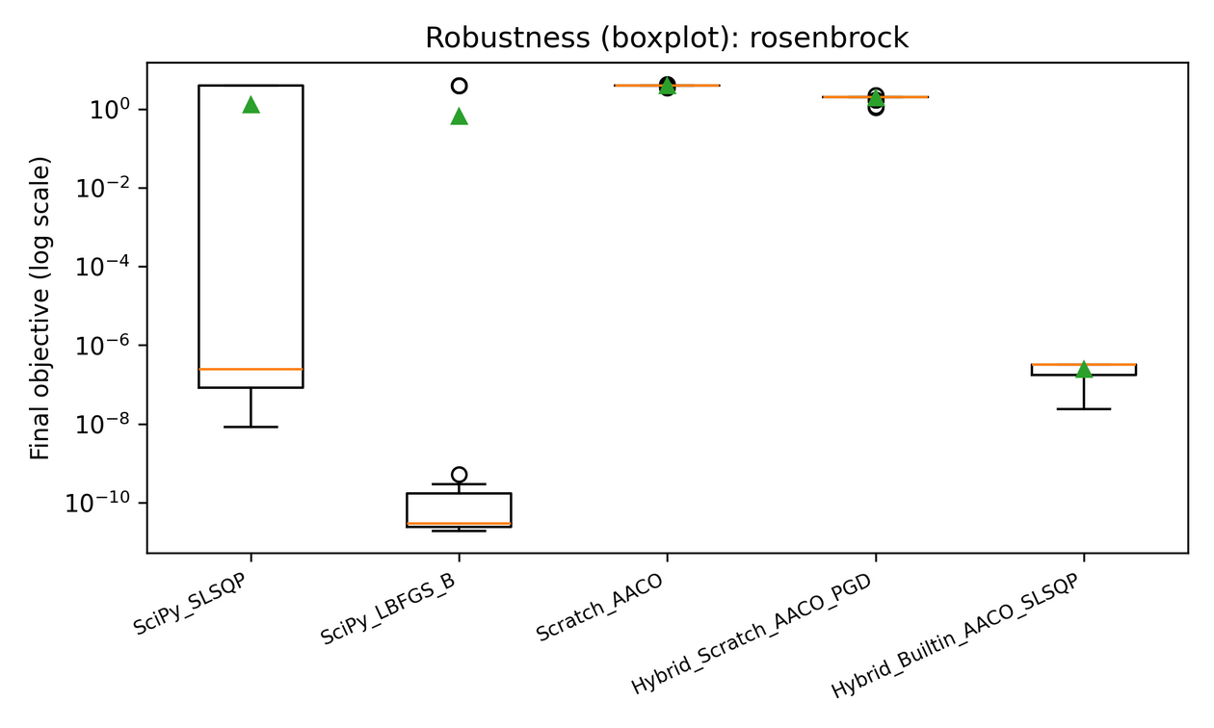
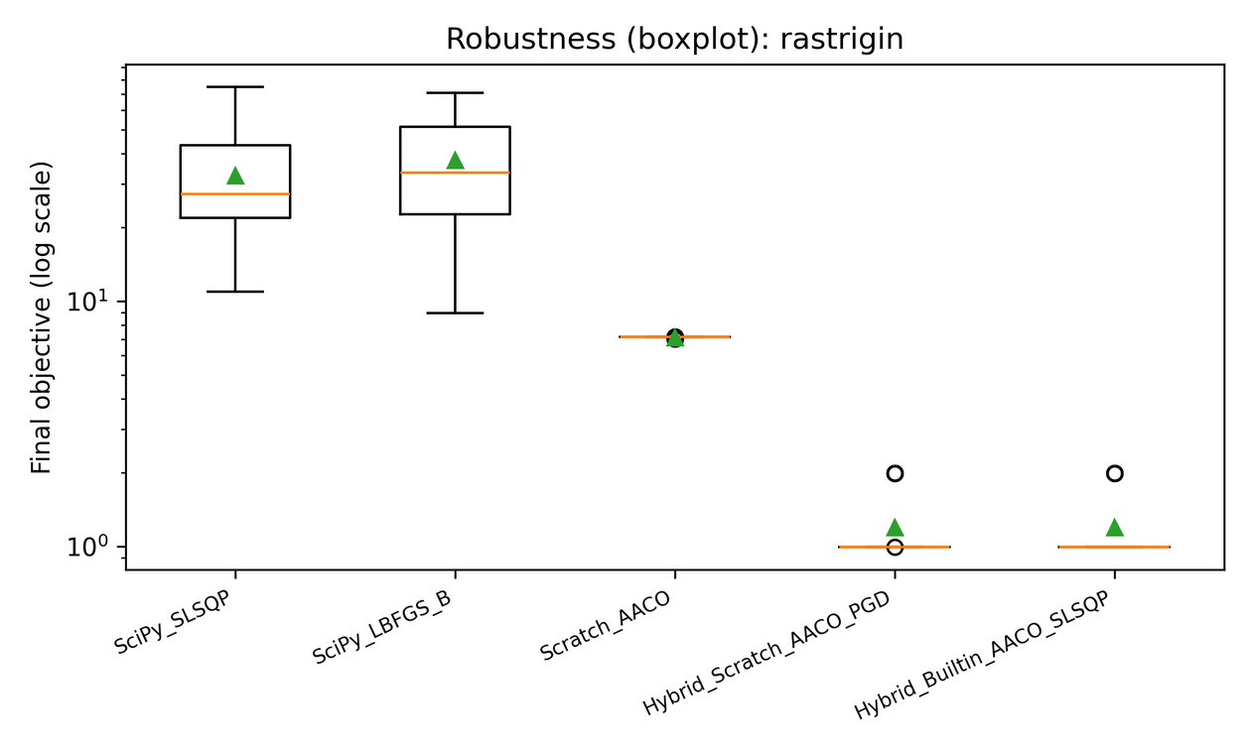
Experimental Results (Boxplots)
12

Slide 13
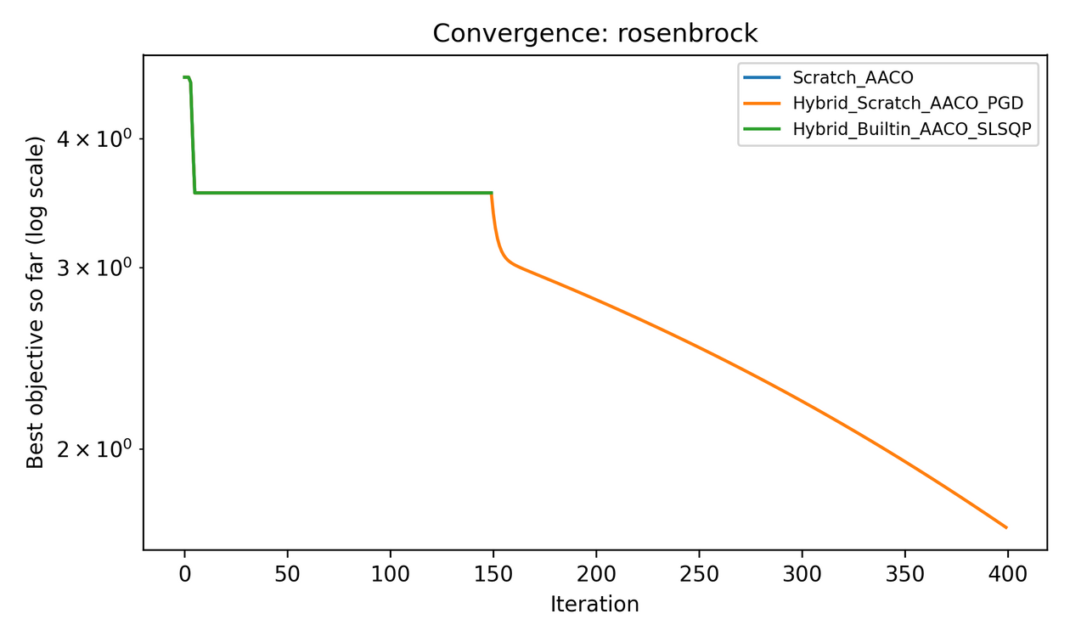
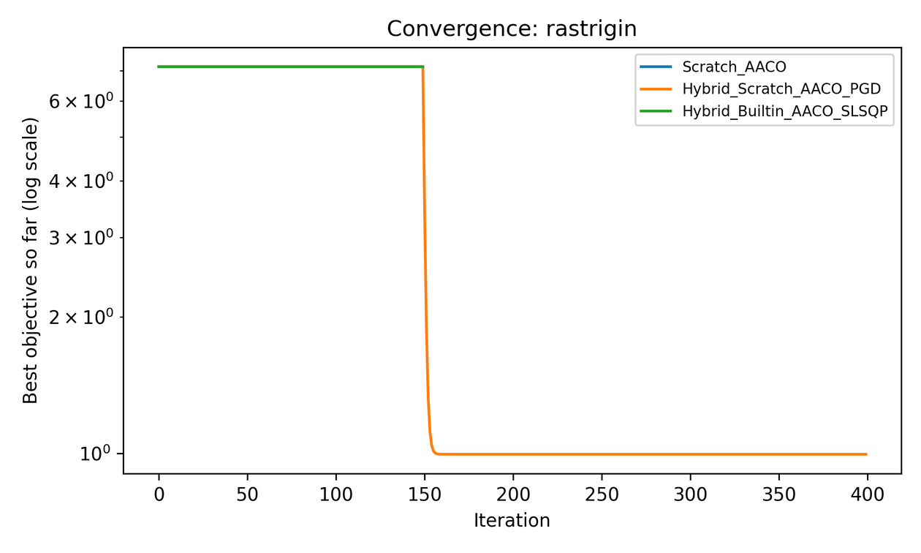
Robustness & Convergence
13

Slide 14
Conclusions & Future Work
Main Conclusions
1. AACO strong at global exploration
2. SQP strong at local refinement
3. Hybrid AACO–SQP: Best of both worlds!
• 10,000× more accurate than pure SciPy (Rosenbrock)
• 26× more accurate than pure SciPy (Rastrigin)
• Robust across 30 runs (minimal variance)
Future Research Directions
• Constrained optimization (inequality/equality constraints)
• Higher dimensions (10D, 20D, 50D)
• Statistical hypothesis testing (ANOVA, t-tests)
• GPU-accelerated implementation (JAX, CUDA)
14

Slide 15
References
[1] M. Dorigo and T. Stützle, Ant Colony Optimization, Cambridge, MA, USA: MIT Press, 2004.
[2] K. Socha and M. Dorigo, “Ant colony optimization for continuous domains,” European Journal of Operational Research, vol. 185, no. 3, pp. 1155–1173, Mar. 2008.
[3] J. Nocedal and S. J. Wright, Numerical Optimization, 2nd ed., New York, NY, USA: Springer, 2006.
[4] H. H. Rosenbrock, “An automatic method for finding the greatest or least value of a function,” The Computer Journal, vol. 3, no. 3, pp. 175–184, 1960.
15

Slide 16
Thank You for Your Attention
30 DECEMBER 2025
16

